Slide 1
Interoperability, security & Safety
KUL 4.0 IIOT
Jan van Deventer

Slide 2
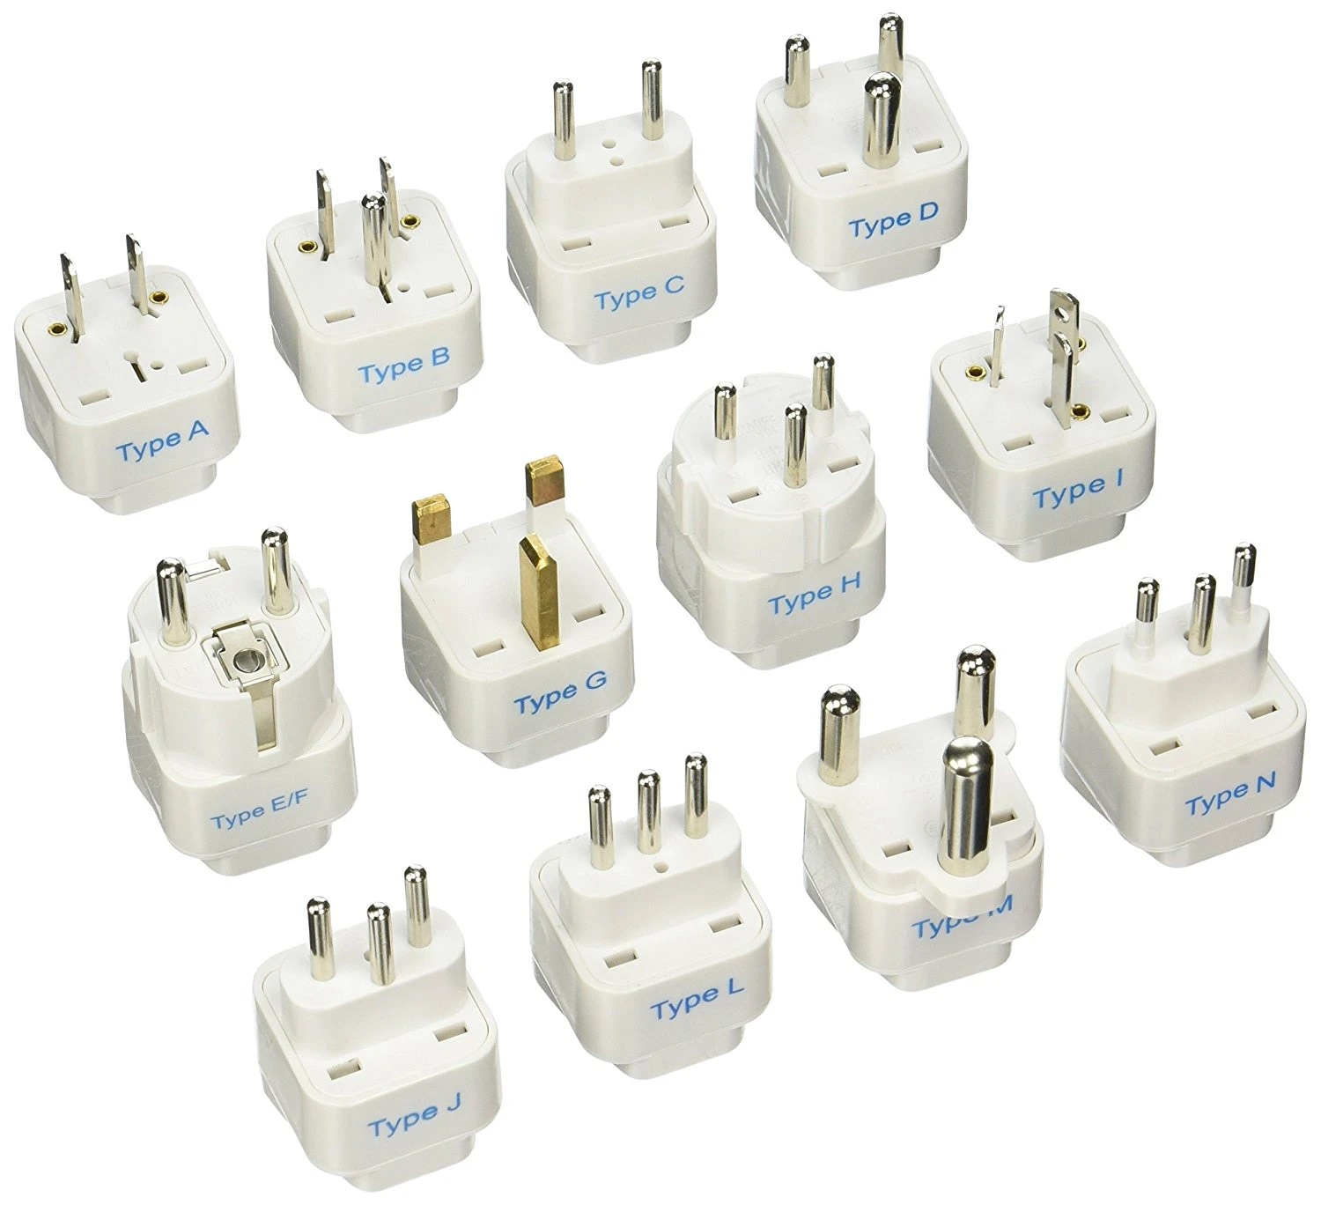
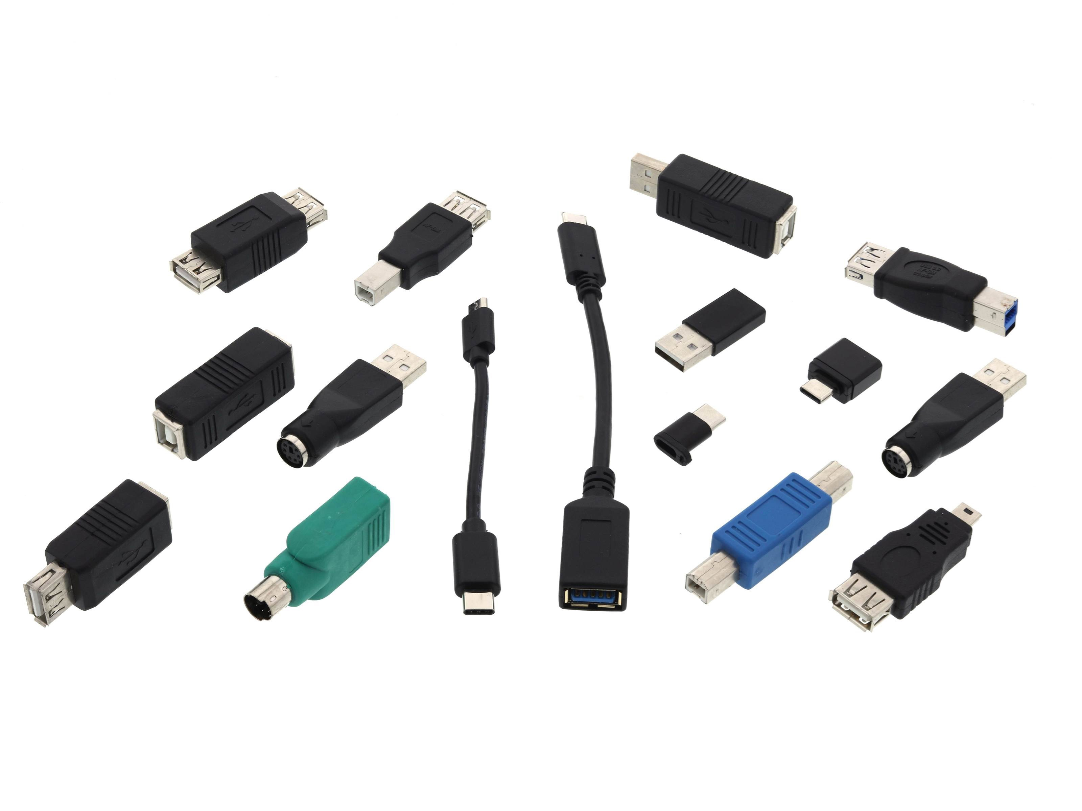
Interoperability
Did you ever travel to another office to make a presentation and could not connect to the projector or power outlet?

Slide 3
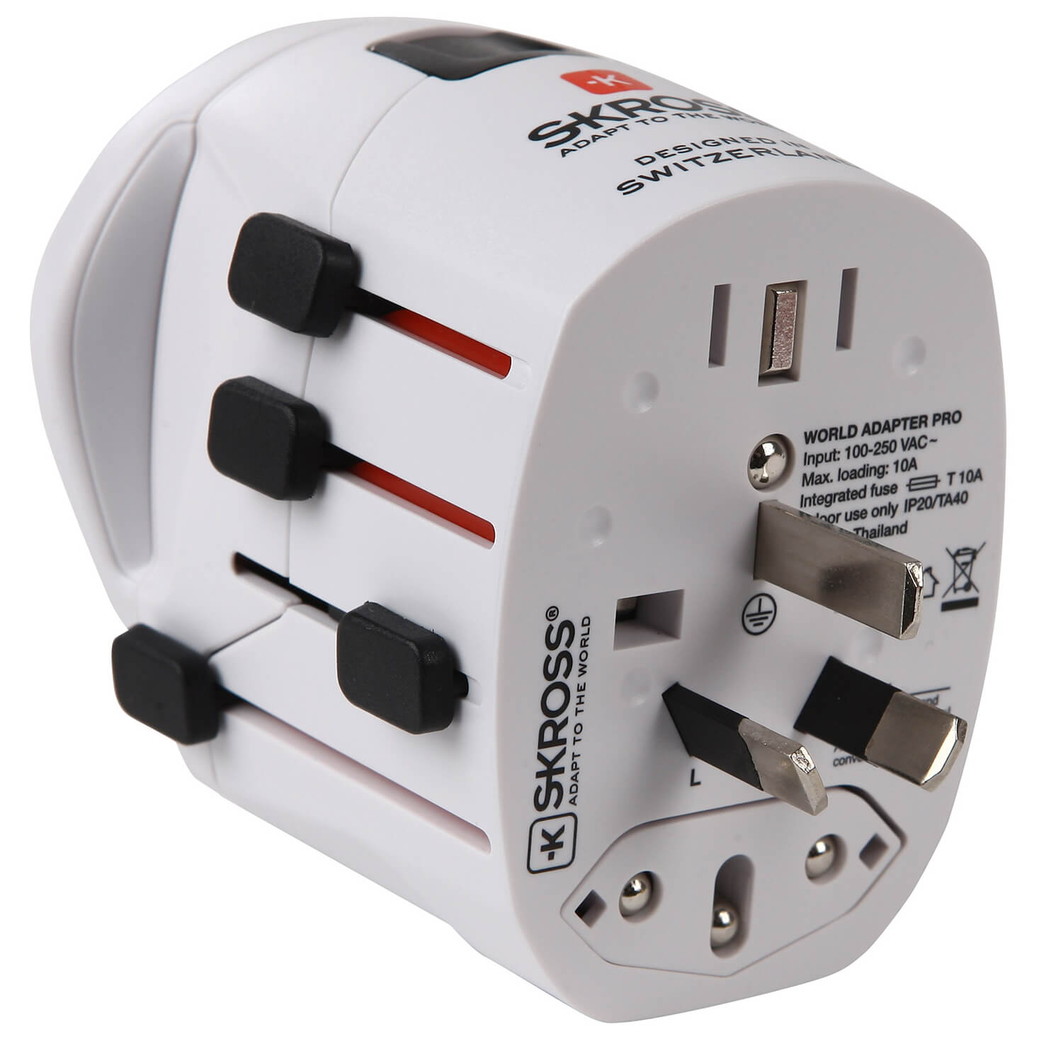
Adapters and Translators
HTML, XML, JSON, ….
HTTP, HTTPS, COAP, SOAP, MQTT,
OPC-UA, Modbus-TCP, ….
Ethernet, WiFi, ….

Slide 4
The IoT problem
Are IoT devices compatible with each other?
Not always => Not acceptable!
Compatible with older or future models?
Not always => Not acceptable!
How do we solve this problem when we have hundred or thousand of IoT devices?

Slide 5
Silly first assignment
First assignment this week might seem silly and comes with fluffy requirements
Provide all possible scenarios, when at the application layer, one might get XML and JSON with CoAP, HTTPS, and MQTT.
consider different “compositions” of a solution,
in which ever form you can imagine (you should not discuss it with others so that you present your unique solution).

Slide 6
Security
Security is a big topic
We are not scratching the surface, just looking.
Safety is a related topic, which is only acknowledged here.
Authentication
Encryption
Authorization

Slide 7
The duality of IoT
The great thing with the Internet we can reach to and communicate (send information from and to) billions of devices.
But,
Due to “privacy”, we do not want to communicate with certain devices.
Due to “integrity”, we do not want our communication to be intercepted by others.

Slide 8

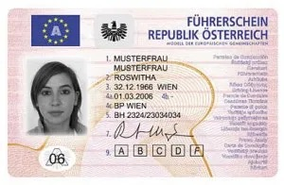
Authentication
Authenticate you are
Trust the authentication

Slide 9
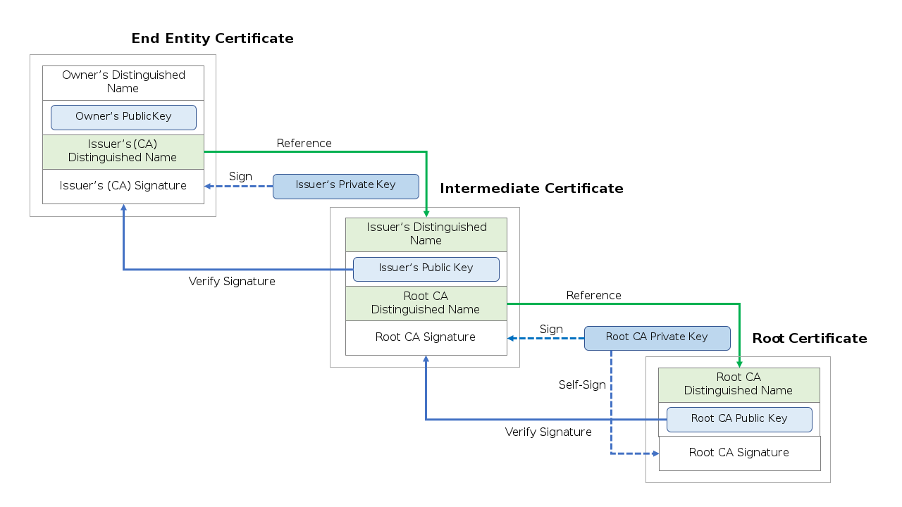
Chain of trust
https://en.wikipedia.org/wiki/Chain_of_trust

Slide 10
Encryption
Information sent over the Internet is visible to all the nodes in the network.
Encryption of the payload provides “privacy” and “tamper proof” mechanisms.
Asymmetric and symmetric keys
Private and public keys

Slide 11
Public key cryptography
Public key cryptography provides the basis for securely sending and receiving messages with anyone whose public key you can access.
Public keys enable:
Users to encrypt a message to other individuals on the system
You can confirm a signature signed by someone’s private key
Private keys enable:
You can decrypt a message secured by your public key
You can sign your message with your private key so that the recipients know the message could only have come from you.
https://www.preveil.com/blog/public-and-private-key/

Slide 12
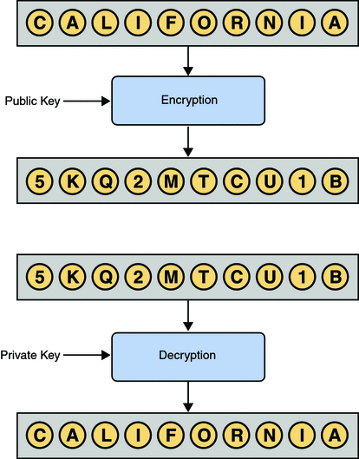
Public and private key
Public-key cryptography is based on the concept of a key pair, which consists of a public key and a private key. Data that has been encrypted with a public key can be decrypted only with the corresponding private key. Conversely, data that has been encrypted with a private key can be decrypted only with the corresponding public key.
https://docs.oracle.com/cd/E19509-01/820-3503/ggbgc/index.html

Slide 13
Certificates
A certificate verifies that an entity is the owner of a particular public key.
Certificates that follow the X.509 standard contain a data section and a signature section. The data section includes such information as:
The Distinguished Name of the entity that owns the public key
The Distinguished Name of the entity that issued the certificate
The period of time during which the certificate is valid
The public key itself
https://docs.oracle.com/cd/E19509-01/820-3503/ggbgc/index.html

Slide 14
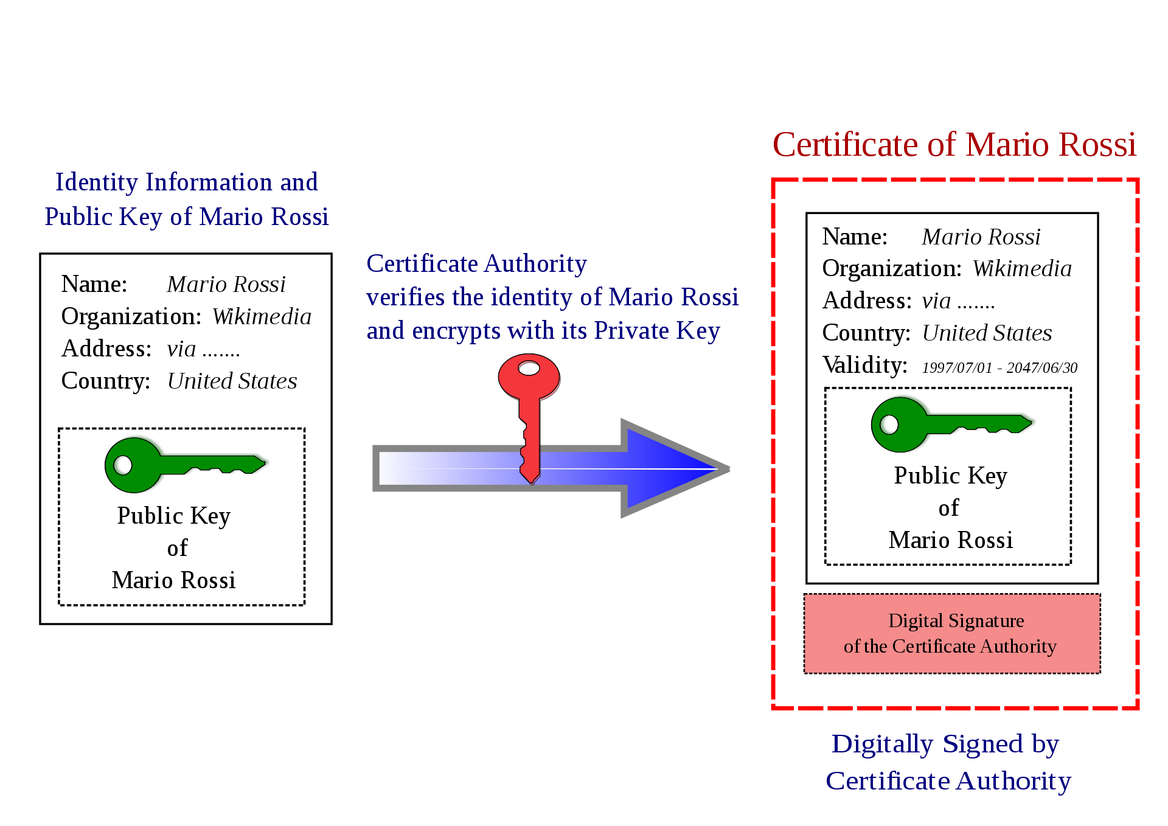
Public keys and certificates
https://en.wikipedia.org/wiki/Public_key_certificate

Slide 15
Second assignment
Using OpenSSL
Encrypt and decrypt a message,
Generate a self proclaimed (signed) Certificate Authority
Generate server public and private keys,
Generate client public and private keys.
Need to use a Linux like environment: Cygwin
Notes:
OpenSSL is a cryptography toolkit implementing the Transport Layer Security (TLS v1) network protocol, as well as related cryptography standards.
OpenSSL provides two command line tools for working with keys suitable for Elliptic Curve (EC) algorithms

Slide 16
Authorization
Authentication has to do with the assurance about the identity of the other entity
Knowing the identity of someone that they should be allowed to access any service they might want.
An underaged person cannot get alcohol at Systembolaget even if the person can show an official identification card.
A data logger should record the states not change them.

Slide 17
Safety
Safety is not Security, but they are related
Safety requirements are just as essential authentication and authorization but are dependent to the use case.
e.g., in a logistics scenario, the delayed delivery of a safety component might put operators at risk.

Slide 18
Synopsis
There must be some requirements in the proposed solution that address interoperability for past, present, and future technologies.
Security includes Authentication and Authorization.
Encryption is also a necessary part of it.
Safety requirements shall be part of the requirements.

